Slide 1
VEHICLE INSURANCE MANAGEMENT SYSTEM
Debabiswa Panda

Slide 2
abstract
Enables both Insurance Admin and Agents in vehicle insurance Inc. to manage database
Admin - manipulate agents and agent details
Agent – manipulates customers and customer details
Agents will be able to see their commission based on number of customers.

Slide 3
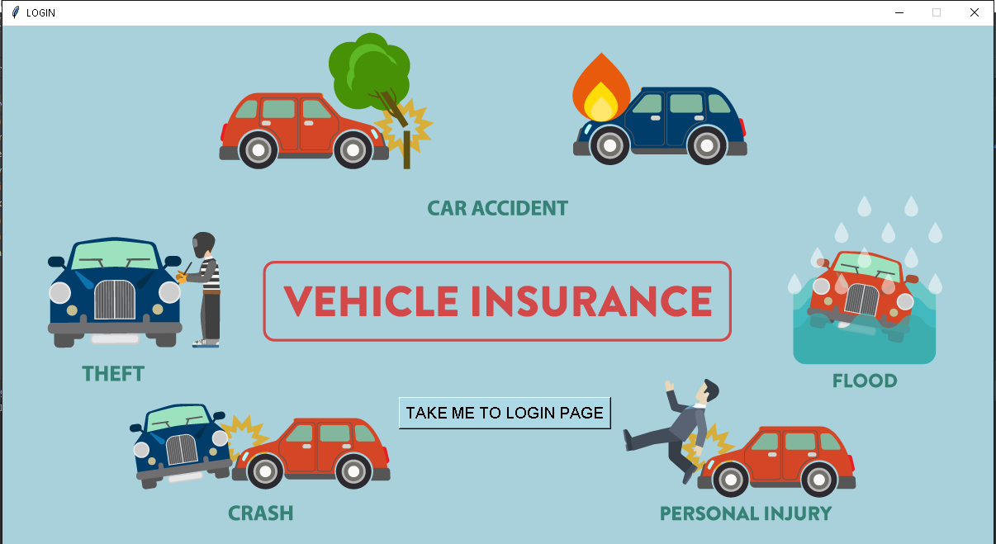
Home Page of Application

Slide 4
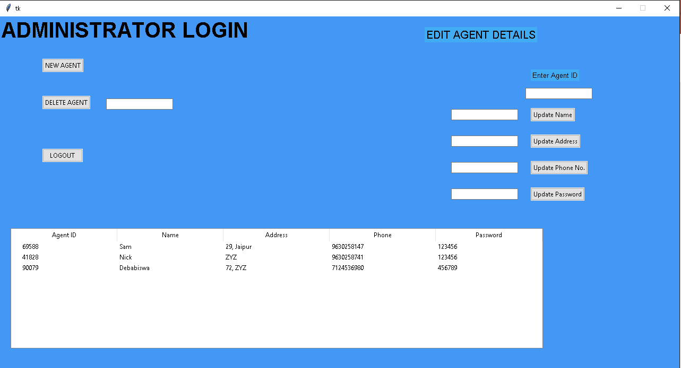
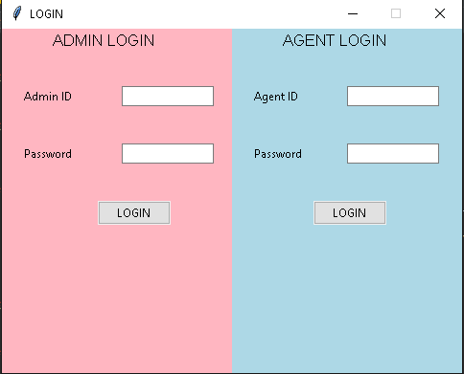
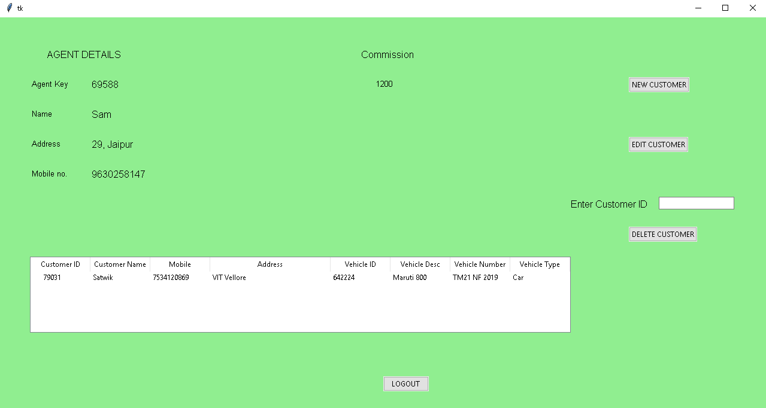

Slide 7
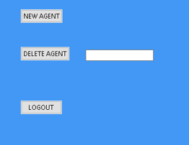
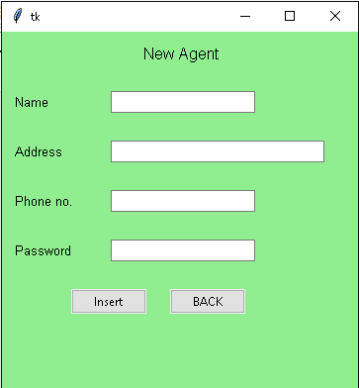
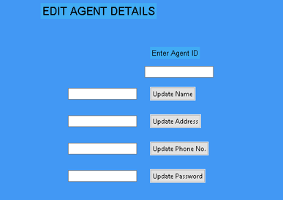
Admin Login Modules

Slide 8
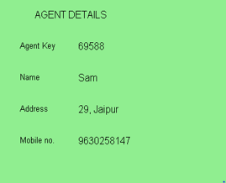
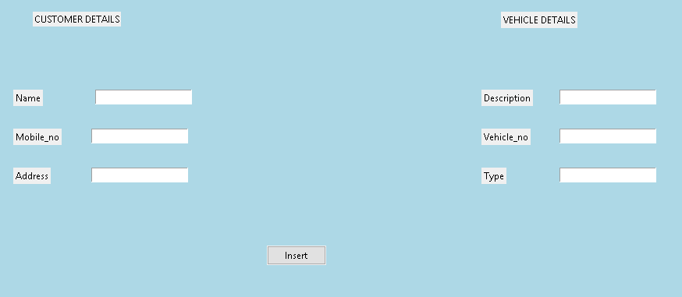
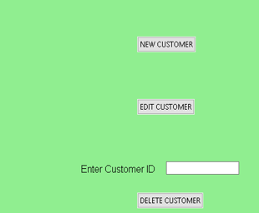
Agent Login Modules

